Slide 1
Finite Element Method using scikit-fem
Adam Grice

Slide 2
Finite Element Method (FEM)
Numerical method for solving PDEs
Divides problem’s domain into smaller elements
Problem solved numerically in each element

Slide 3
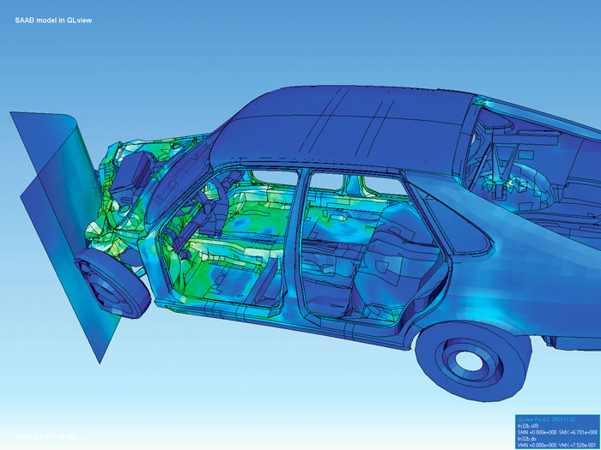
FEM--Applications
Commonplace in engineering, used for analyzing structural mechanics, fluid flow, heat transfer, mass transport, etc.
Public Domain, https://commons.wikimedia.org/w/index.php?curid=641911

Slide 4
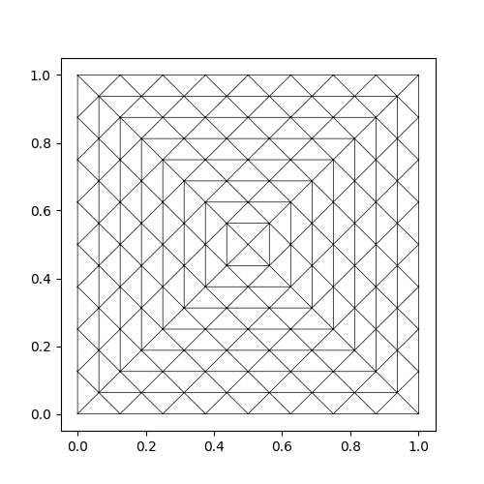
FEM--Terminology
Element: a single sub-domain
Mesh: collection of elements
Facet: edge of an element
Node: vertex of an element

Slide 5
How it Works
PDE approximated algebraically in each element
Algebraically for steady-state problems, with ODEs for transient
Method of solution varies
Elements only affected by boundaries with their direct neighbors

Slide 6
Implementation
Define mesh
Size, shape, element geometry
Choose basis
Set of functions which will approximate the PDE

Slide 7
My Project
Take existing problem and modify it
scikit-fem has large bank of example code
Chose plate-bending problem

Slide 8
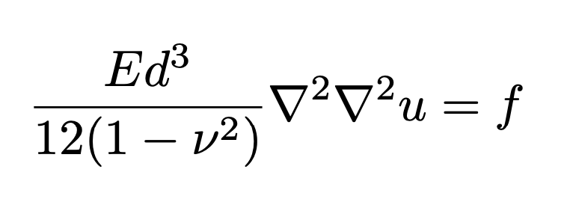
Kirchhoff-Love Plate Bending
Equation describing deflection of isotropic, homogeneous plates
Notes:
E is Young’s modulus, a measure of stiffness under tension or compression. Nu is Poisson’s ratio, a measure of deformation in directions perpendicular to load. F is load, u is deflection, and d is thickness.

Slide 9
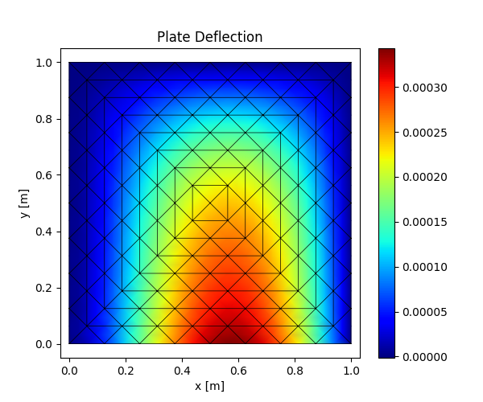
Original Solution
Steel plate clamped on three sides, 10cm thick
Uniform load applied at bottom edge
Notes:
Force on order of 10^6 N

Slide 10
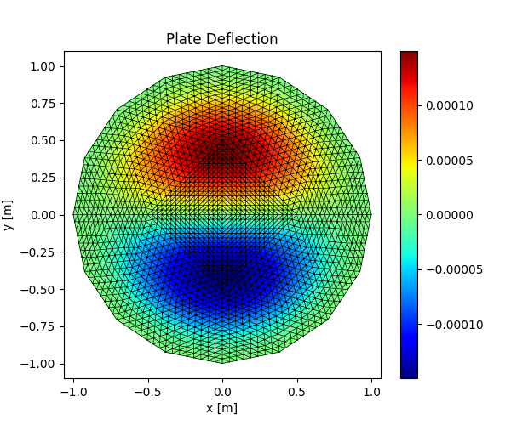
Modified Problem
Circular-ish mesh, smaller elements
Thinner plate, 1mm thick
Clamped on border
Changed loading force to be sinusoidal

Slide 11
Extensions and Problems
Would like to better understand how to modify mesh and B.C.s
Still in Cartesian coordinates, couldn’t figure out conversion to cylindrical

Slide 12
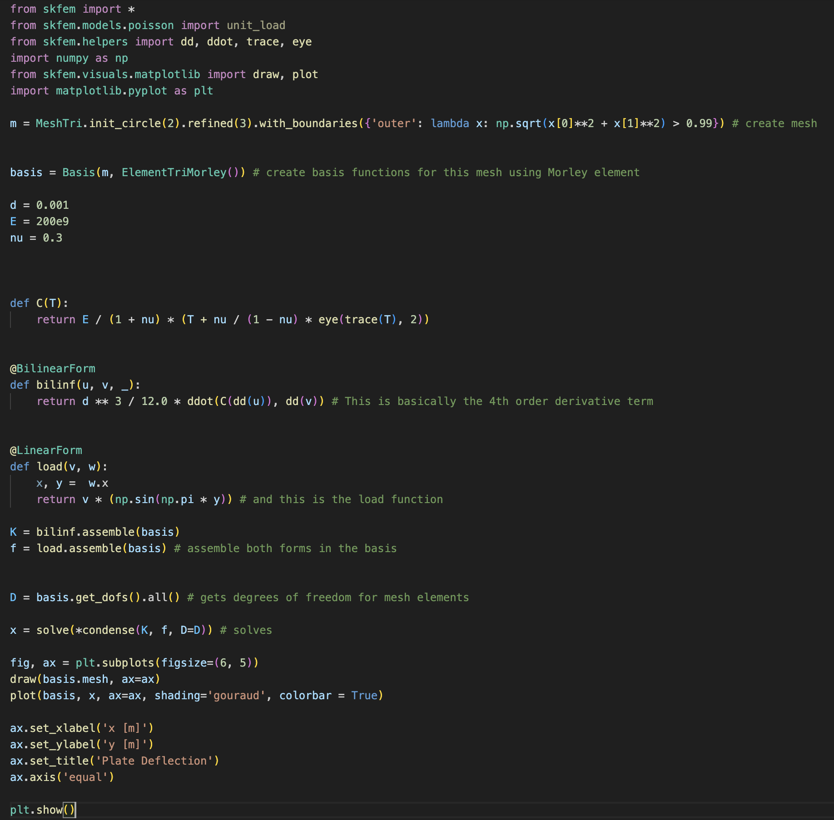
My Code

